Slide 1
CHEF –ITS Package Deployer
---Saurabh / PABITRA

Slide 2
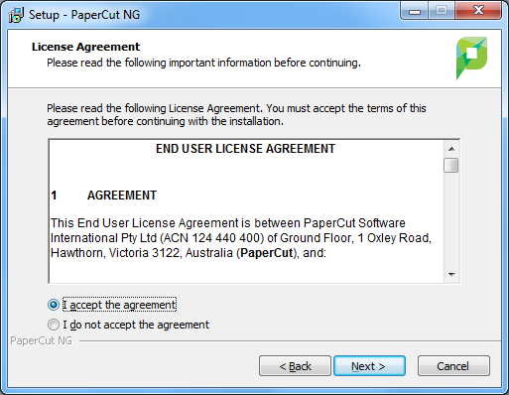
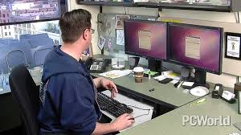
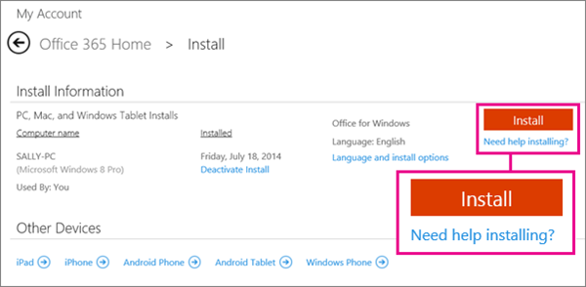



Real Time problems

Slide 3
How chef will help
Chef Server will contain all the packages to be installed on the windows machine
Chrome
Visual Studio
Java
Office
Firefox
Acrobat Reader

Slide 4
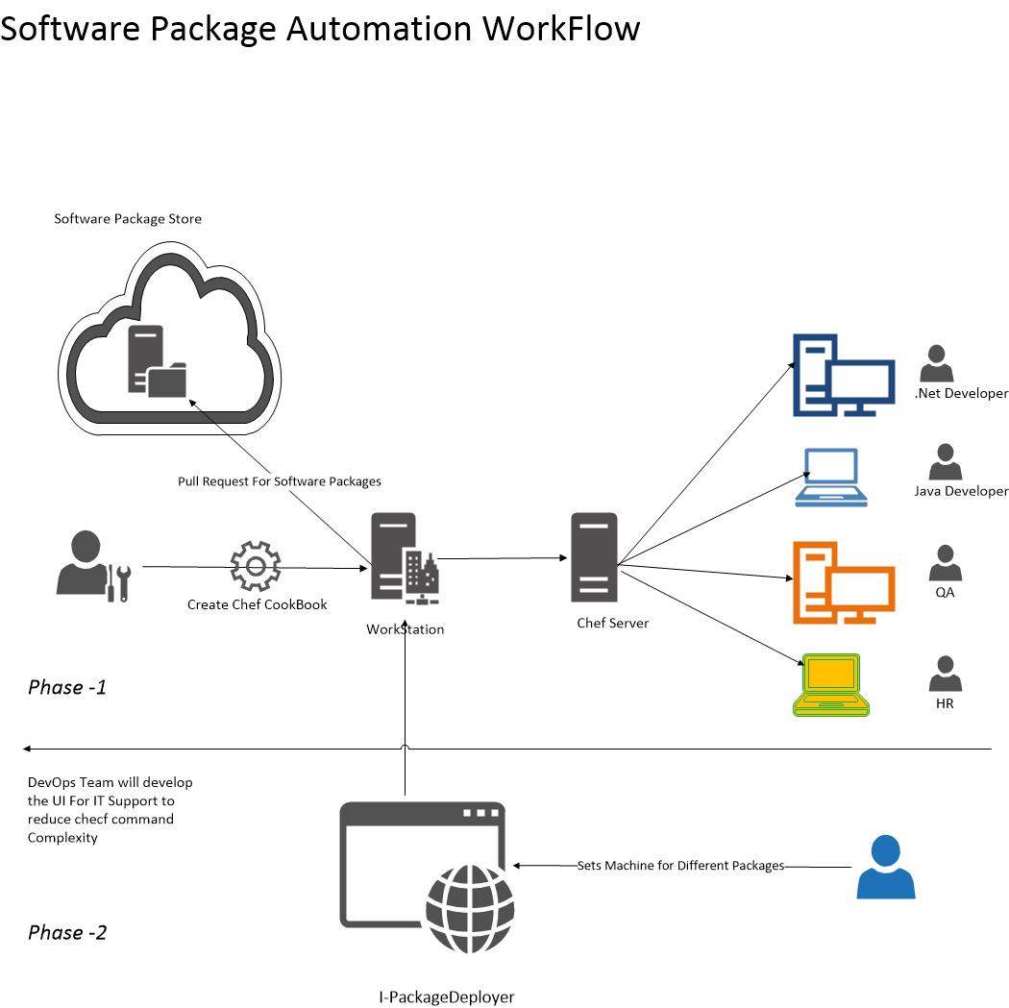
Chef Architecture

Slide 5
Pre-Requisites
1. Winrm should be enabled
2. Add these policies as well to devops.user1 to copy the package to windows machines
i. Administrative->Local Policies->User Right Assignment -> Adjust Memory quotas for a process
ii. Administrative->Local Policies->User Right Assignment -> Replace a process Level token

Slide 6
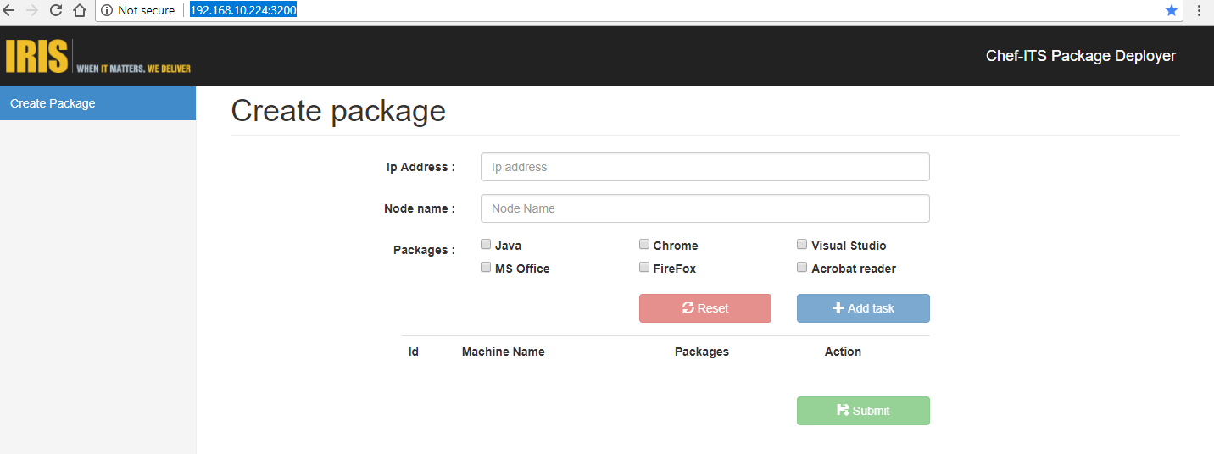
Steps
1. Goto URL -> http://192.168.10.224:3200/

Slide 7
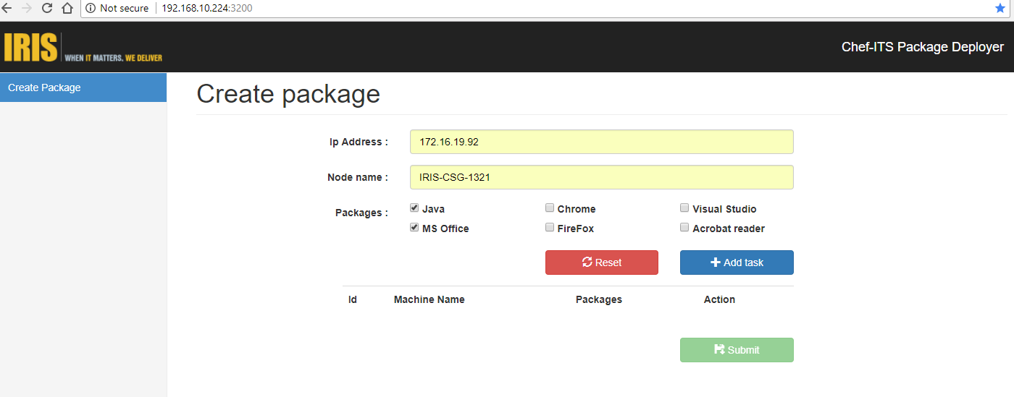
Step 2

Slide 8
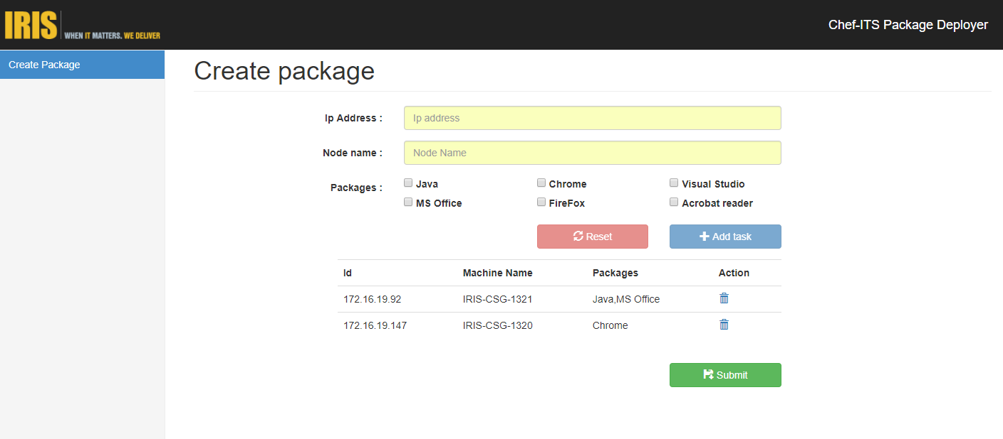
Step 3 – Add the detail

Slide 9
Step 4 – Final Submission

Slide 10
Chef backend Implementation
Chef tool will start the installation
It will install the packages in sequential state
The node input first enter will be installed first
It will copy the packages from shared location to client
It will begin the installation

Slide 11
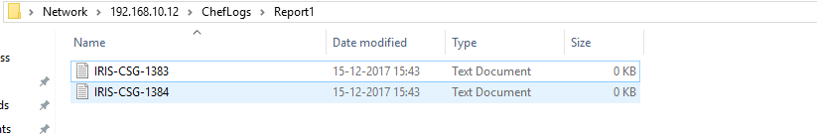
Verfication
1. Goto shared location \\192.168.10.12\ChefLogs\Report
2. Select the file to verify the status. Files will be saved with the machine name selected for installation
3. Select the file and verify the status

Slide 12
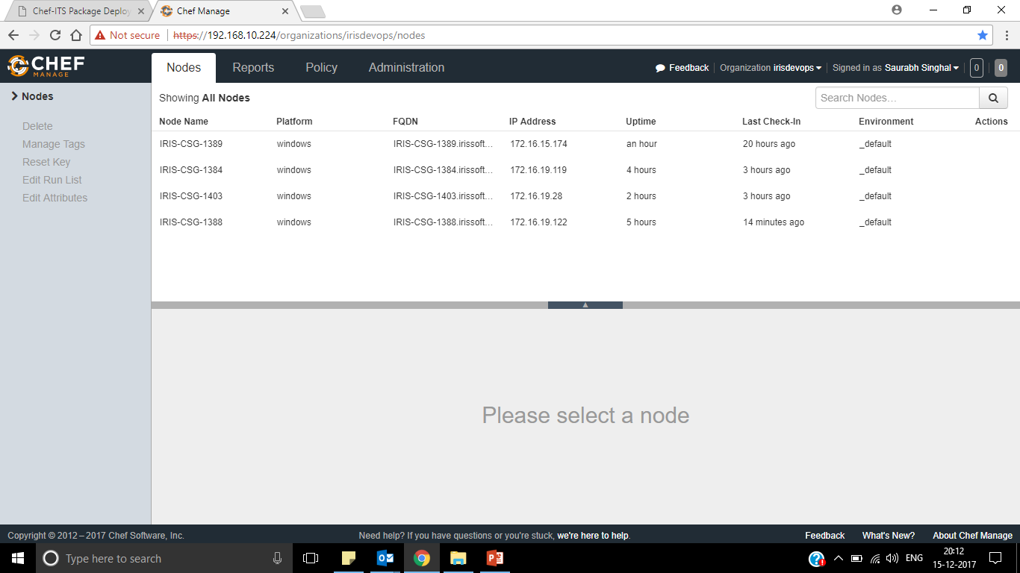
Chef Server
1. Login to the chef server URL (singhalsaurabh20@gmail.com/password@1)
https://192.168.10.224
2. Click on Nodes to verify the workstation bootstrapped by Chef

Slide 13
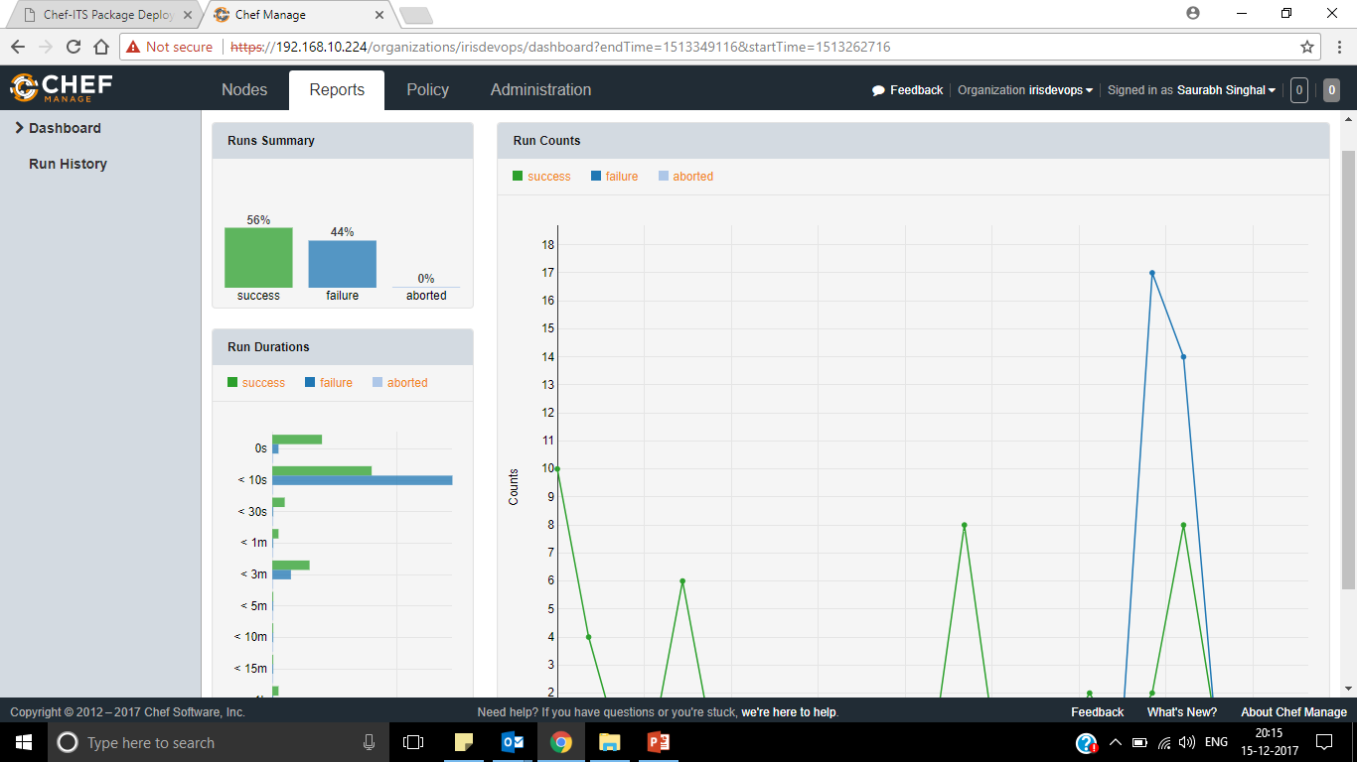
Reports – Success and Failure Status

Slide 14
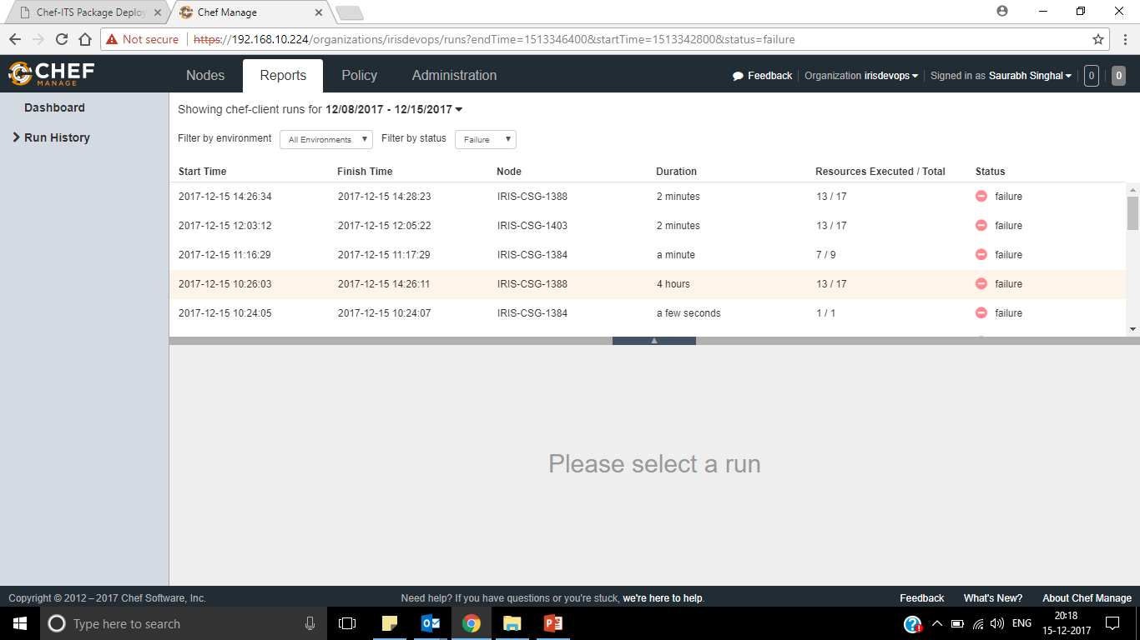
Failure Reports – Non Graphical View

Slide 15
Any Suggestion

